Slide 1
CCNA AND SECURITY
TRAINED BY:
SUBMITTED BY:MUSTAF AIDARUS
REGISTRATION NO:1171

Slide 2
content
About ccna.
Network.
Basic Requirements of a network.
OSI Model.
Routing configuration.
Types of routing.
AAA server.

Slide 3
ABOUT CCNA
ccna is Cisco Certified Network Associate
It builds a foundation for the knowledge of networking.
ccna certified professionals can install and operate LAN, WAN, and access services for small networks.

Slide 4
NETWORK
network- two or more devices interconnected
networking- enabling communication between devices.
internetwork- connecting two or more networks.
internetworking-
communication between twe or more networks
types of network:
LAN
WAN

Slide 5
BASIC REQUIREMENTS TO FORM A NETWORK
NIC Card(network interface card).
Physical/Hardware address.
MAC Address: 48 bits, it holds 12 Hexa-Decimal Numbers.
Media.
Networking device.
Logical address.
Protocols.

Slide 6
OSI Model
Why do we need OSI model ?
To address the problem of networks increasing in size and number, the International Organization for Standardization have done as research and recognized that there was a need to create a network model.
This would help network builders to implement networks that could communicate and work together.

Slide 7
OSI Model
Why do we need OSI model ?
To address the problem of networks increasing in size and number, the International Organization for Standardization have done as research and recognized that there was a need to create a network model.
This would help network builders to implement networks that could communicate and work together.

Slide 8
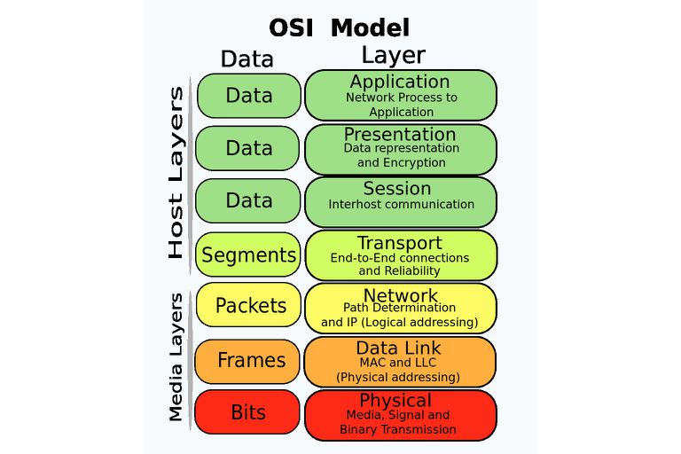
OSI Model
OSI Model describes on how data is transferred from an application from one computer to another.
OSI model composed of seven layers that describes the functions of data communication protocols.
each layer of OSI model describes a particular network function.

Slide 9
Routing configuration
Basic command of routing
user mode
Router >
privilege mode
Router > enable
Router#
configuration mode
Router # configuration terminal
Router (config)#
Router (config)#hostname R1

Slide 10
Interface mode
Router (config)# interface serial/fast Ethernet
Router (config-if)# ip address subnet mass
Router (config-if)# no shutdown
Router (config)#clock rate 64000
Show Command
R# show running-configuration
R# show IP interface brief
R# show version
R# show IP interface brief

Slide 11
TYPES OF ROUTING
static routing
it is configured by administrator manually
mandatory to know destination.
Its secure and fast.
Useful for small organizations.
Command of static routing
R(config)#ip routing destination network destination mask next hope IP.

Slide 12
Dynamic routing
There is no need to know the destination network.
Administrative work is reduced.
Types of dynamic routing
Distance vector
Link state protocol
Hybrid protocol

